Slide 1

SpaceX Launch Analysis
Presented by
YouJia Chen

Slide 2
Agenda
Executive Summary
Introduction
Exploratory Data Analysis
Statistical Analysis
Results
Conclusion

Slide 3
Executive Summary
SpaceX revolutionizes the space industry by offering Falcon 9 rocket launches at a cost of $62 million, significantly lower than competitors' prices.
This remarkable cost reduction is achieved through the innovative practice of reusing the first stage.
In this project, our goal is to predict the landing success of the first stage, enabling accurate cost estimation for rocket launches. By analyzing historical data and applying machine learning algorithms, we aim to develop a predictive model that can be used for competitive bidding against SpaceX.
Additionally, we consider the geographical significance of launch sites, which are strategically located near coastlines and the equator to optimize trajectories and facilitate access to various orbital inclinations.
This project holds the potential to provide valuable insights for the industry, empowering decision-makers with precise cost estimates and enhancing bidding strategies.

Slide 4
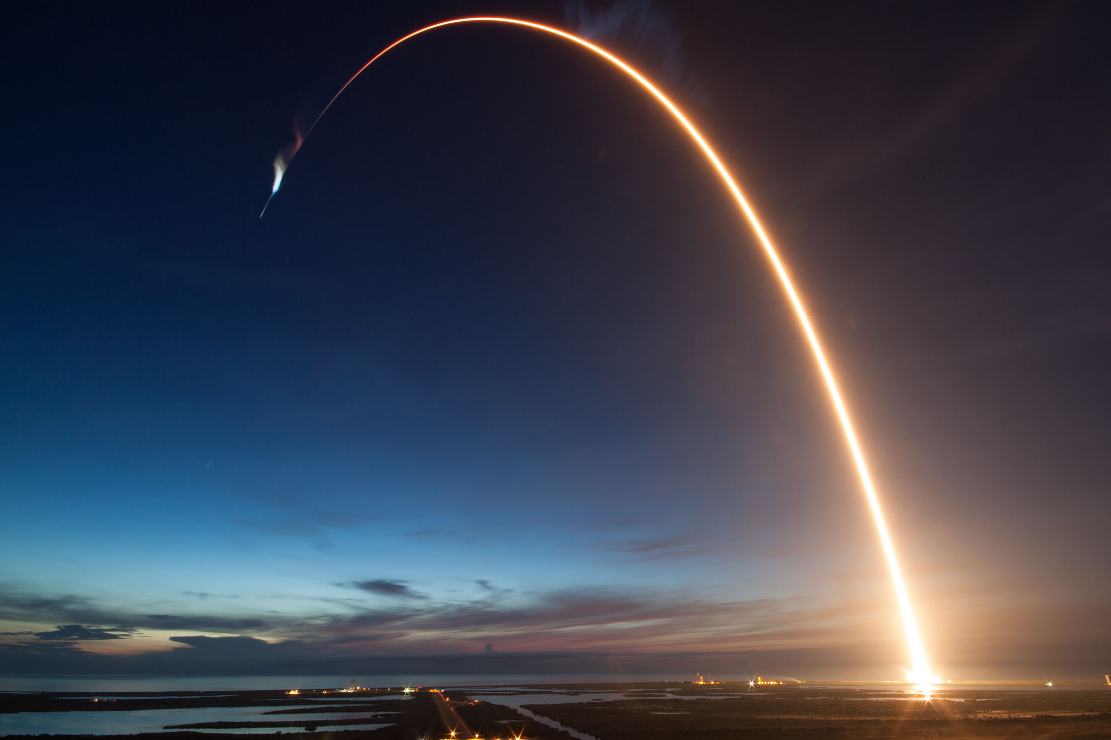
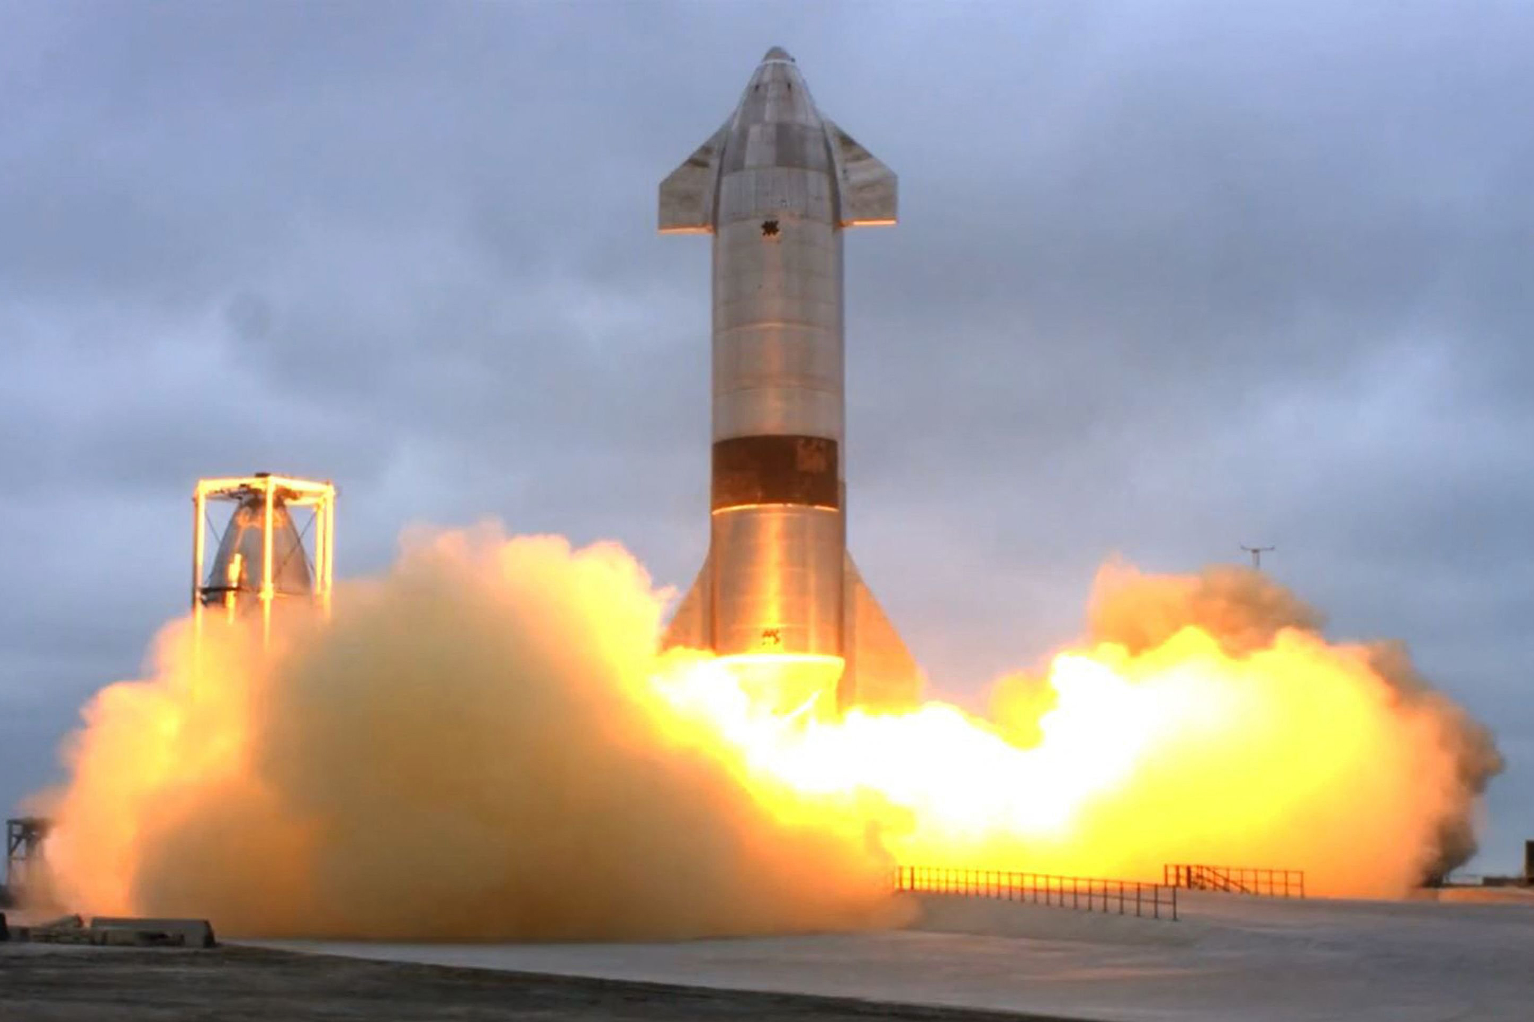

Introduction
SpaceX offers Falcon 9 rocket launches at an unbeatable price of 62 million dollars.
Competitors charge over 165 million dollars for similar services.
The cost reduction is made possible by SpaceX's groundbreaking approach of reusing the first stage of their rockets.
This innovation has transformed the economics of space travel.

Slide 5
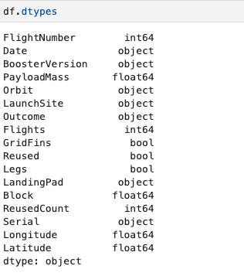
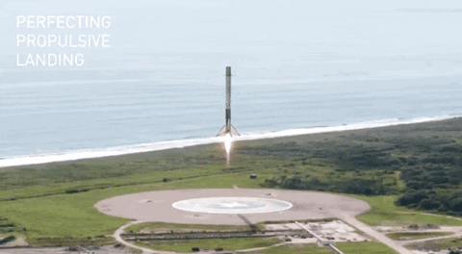
Data Collection And Data Wrangling Methodology
API
Web Scrabbing from Wikipedia
Create new column ‘Class’, 1 for success, 0 for fail

Slide 6
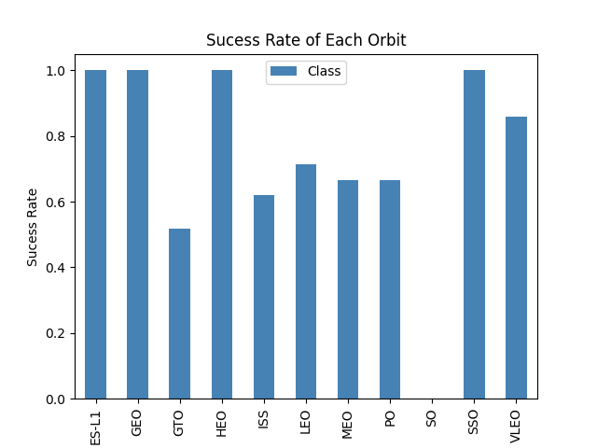
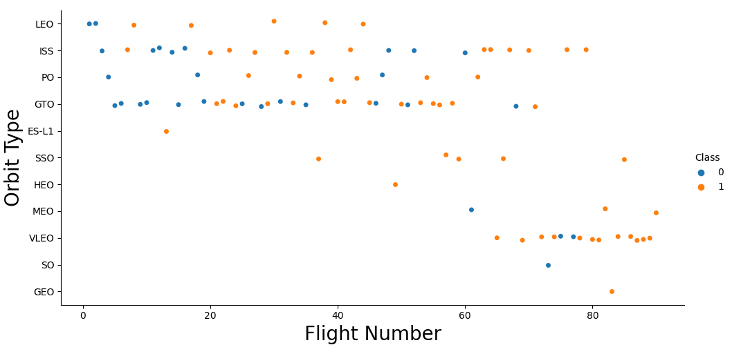
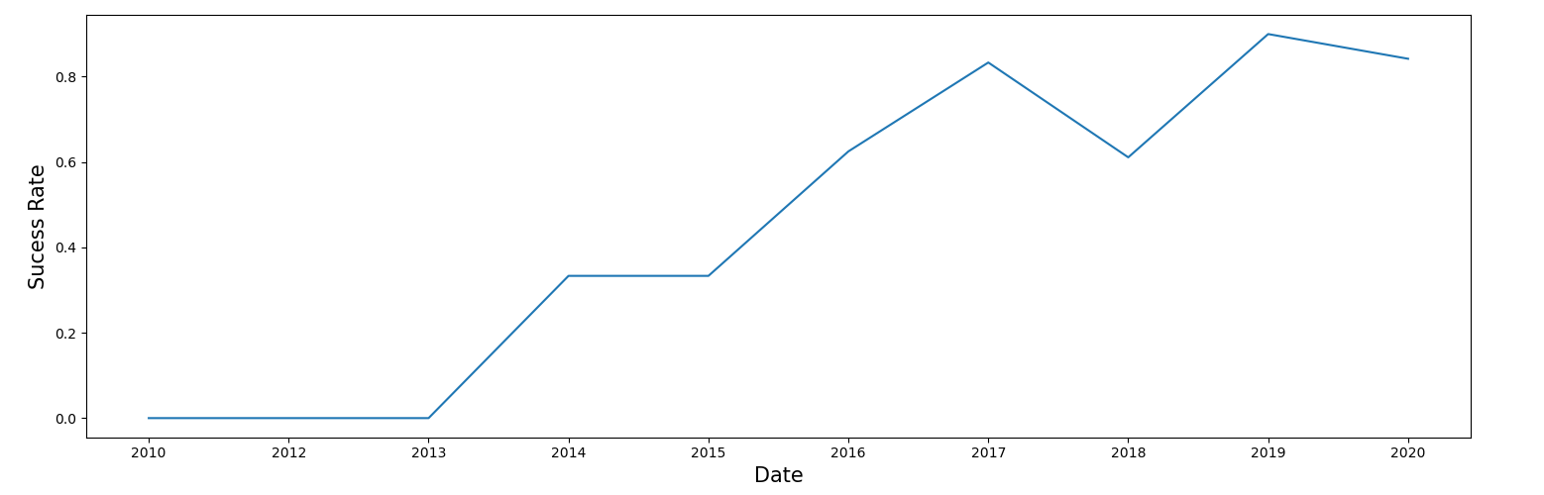
EDA with visualization results

Slide 7
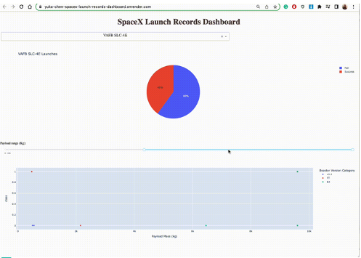
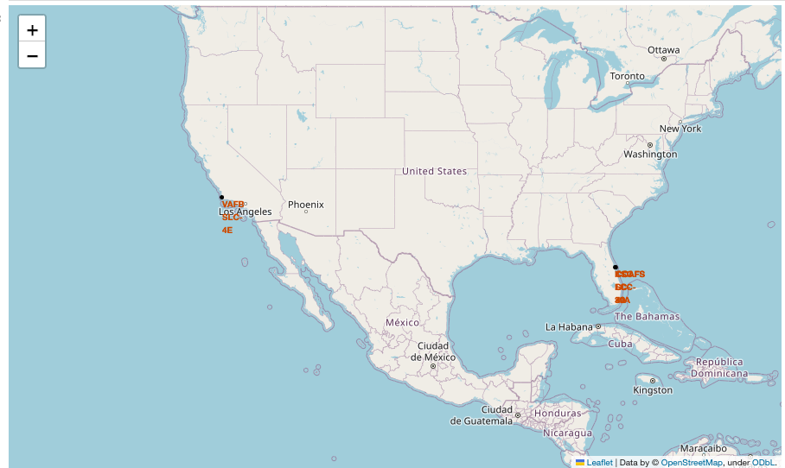
EDA and interactive visual analytics methodology
Folium for interactive map analysis
Plotly for interactive visual analysis (pie and scatter plot)

Slide 8
Predictive Analysis Methodology
Create a column for the class
Standardize the data
Split into training data and test data
Find best hyperparameter for SVM, Classification trees and Logistic Regression

Slide 9
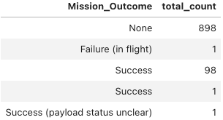
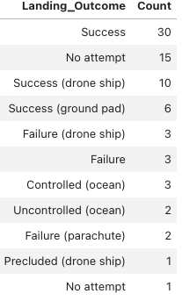
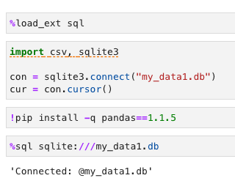
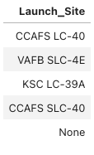
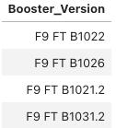
EDA with SQL(ite)

Slide 10
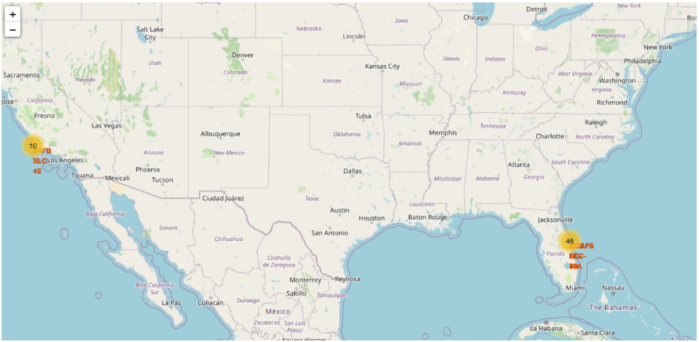
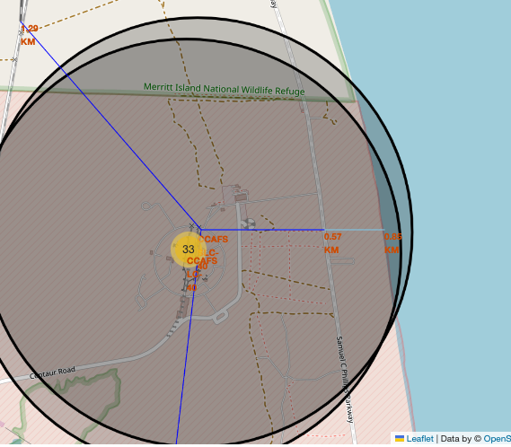
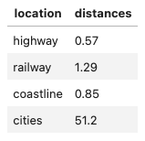
Interactive map with Folium

Slide 11
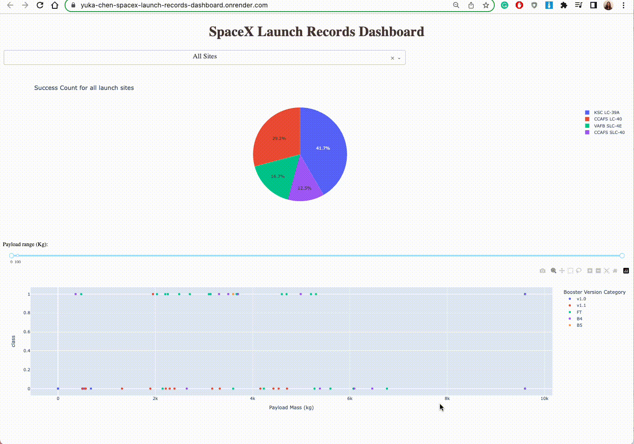
Plotly Dash dashboard
https://yuka-chen-spacex-launch-records-dashboard.onrender.com/

Slide 12
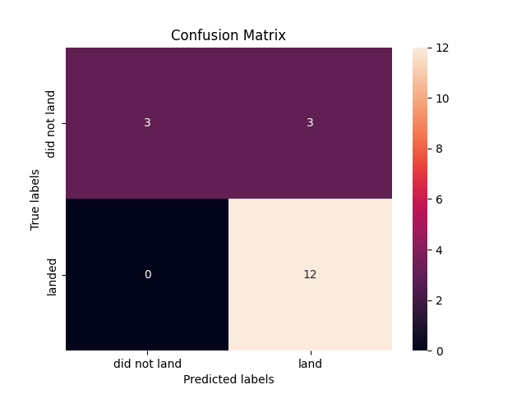
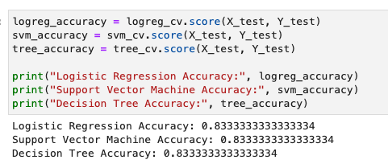
Predictive Analysis (Classification)
Three methods all have 83.33% accuracy

Slide 13

Conclusion
Launch Sites Success Rate
CCAFS LC-40: 26.9% (Florida)
CCAFS SLC-40 : 42.9% (Florida)
KSC LC-39A : 23.1% (Florida)
VAFB SLC-4E : 40% (California)
Proximity to coastlines:
Allows for safer abort scenarios and emergency contingencies during launch.
Simplifies transportation logistics for rocket components.
Facilitates integration and assembly processes.
Proximity to the equator:
Provides an inherent velocity boost from the Earth's rotation.
Reduces the amount of fuel required for achieving orbit or reaching destinations.
Increases payload capacity or extends the operational lifespan of satellites.
Enables access to a wider range of orbital inclinations.
Strategic advantages:
Maximizes operational efficiency and safety.
Enhances payload capabilities.
Offers flexibility and versatility for space missions.

Slide 14
Appendix

